Slide 1
IS MS DHONI STILL RELEVANT?

Slide 2
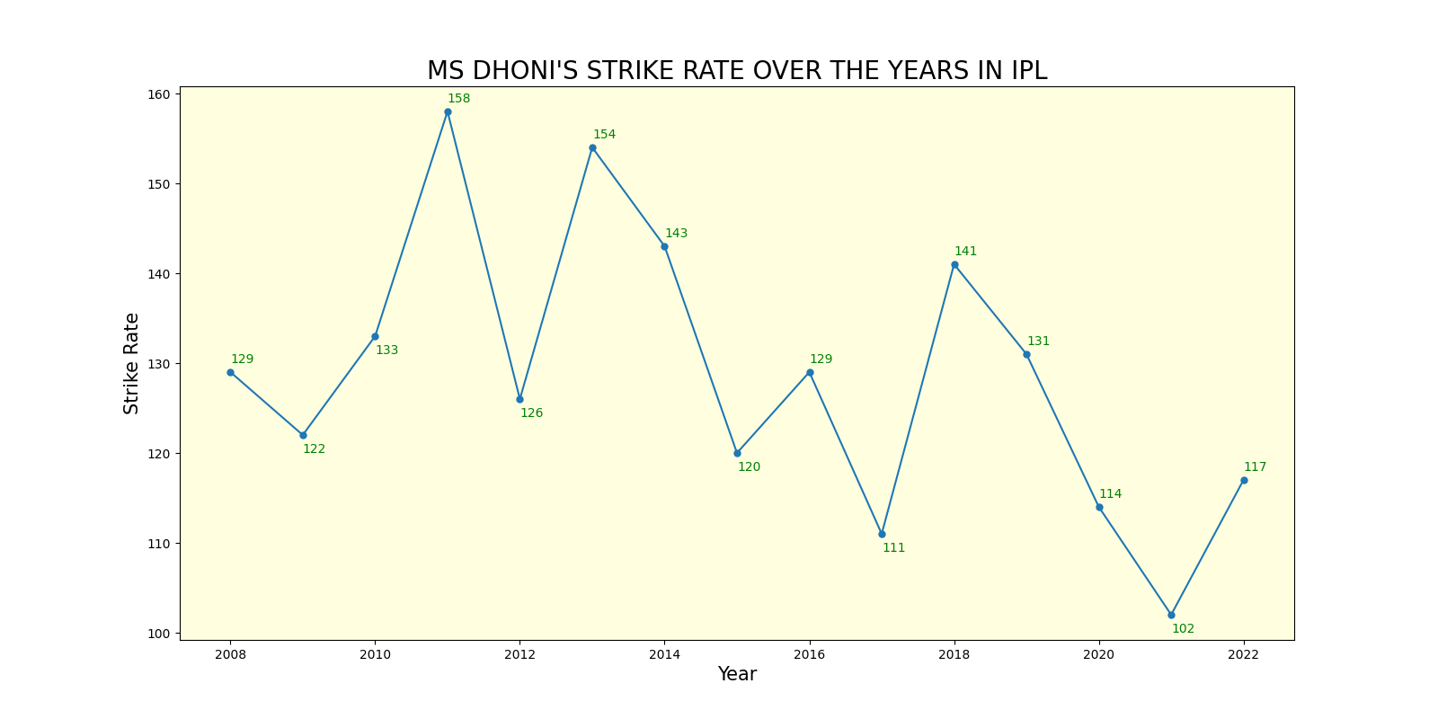

Slide 3
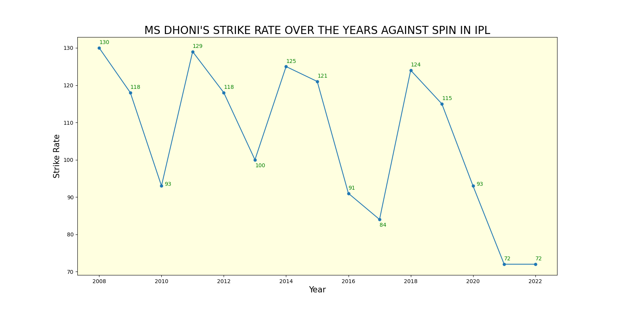

Slide 4
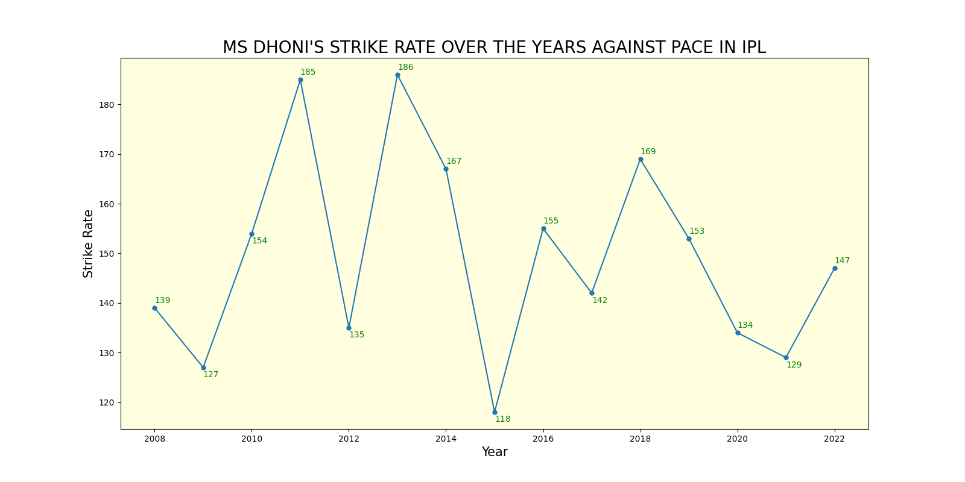

Slide 5
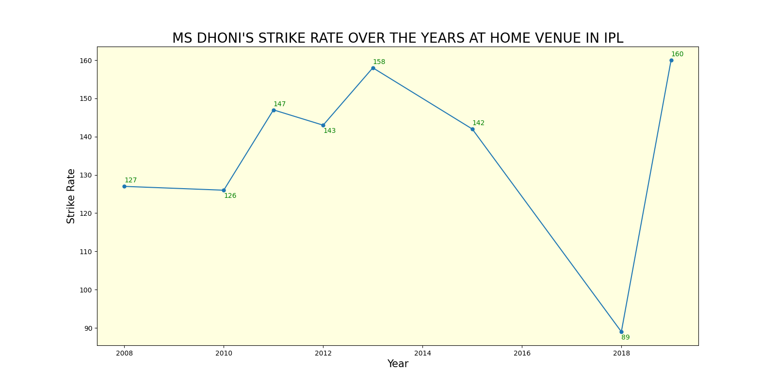

Slide 6
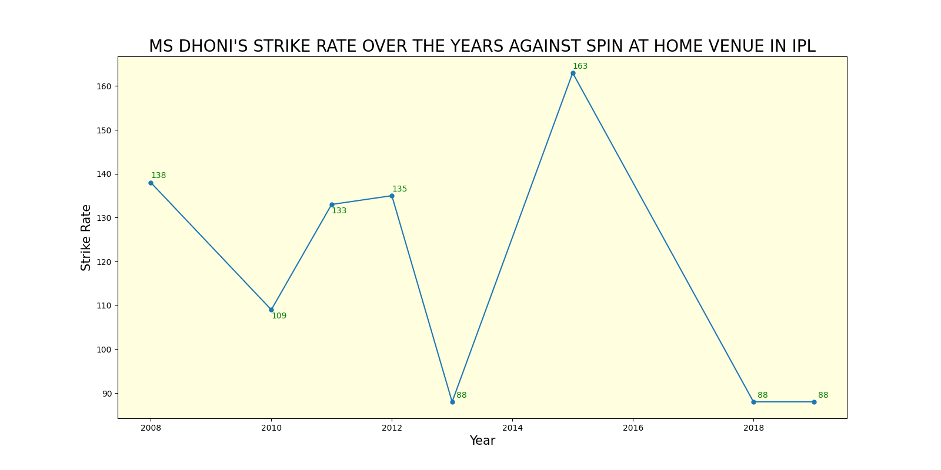

Slide 7
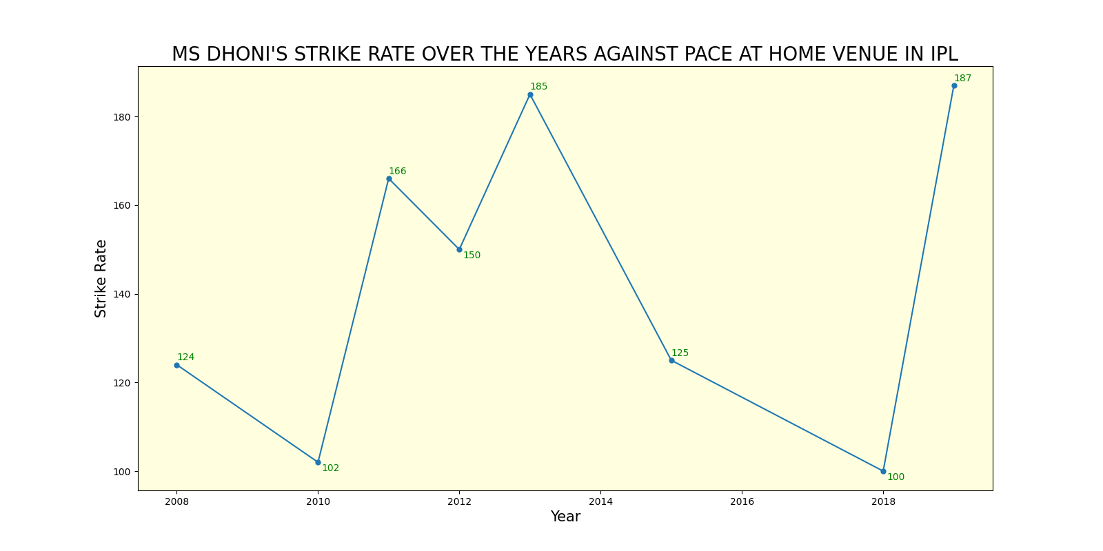

Slide 8
CONCLUSION:
First 3 charts shows that over the years, strike rate has dropped and in particular against spin MSD struggles.
For any ipl team home games are most important. As 7 out of 14 games are at home venue.
Last 3 charts shows that at home venue, MSD is great against pace and struggles against spin here too.
we can conclude that he is relevant, but in very specific part of the game(at death overs) and against specific bowling type(pace).
As a finisher if he arrives at the death overs during pacer’s bowling, He can still perform.

